Slide 1
LAN Design
LAN Switching and Wireless – Chapter 1

Slide 2
Objectives
Describe how a hierarchical network supports the voice, video and data needs of a small and medium-sized business.
Match the appropriate Cisco switch to each layer in the hierarchical network design model.

Slide 3
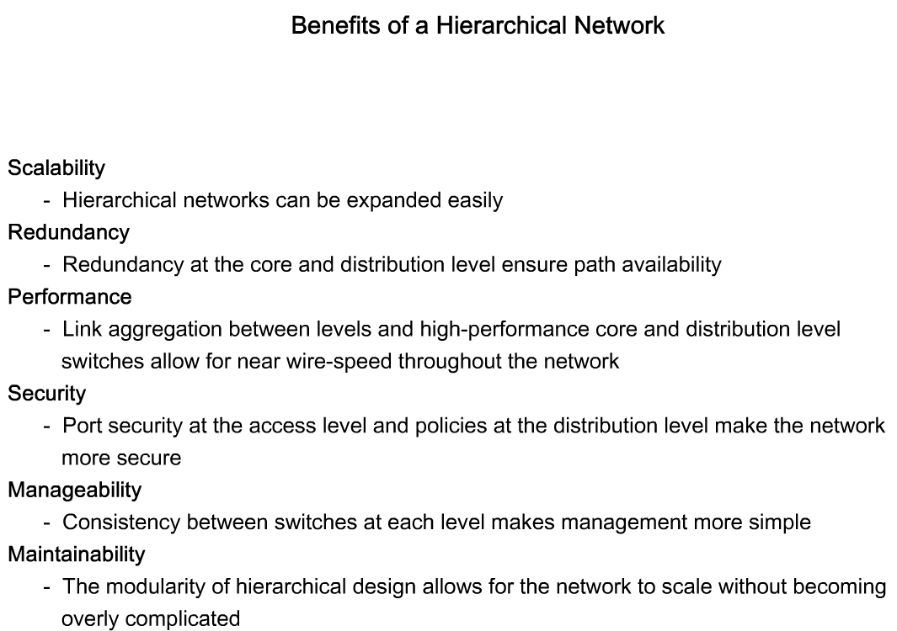
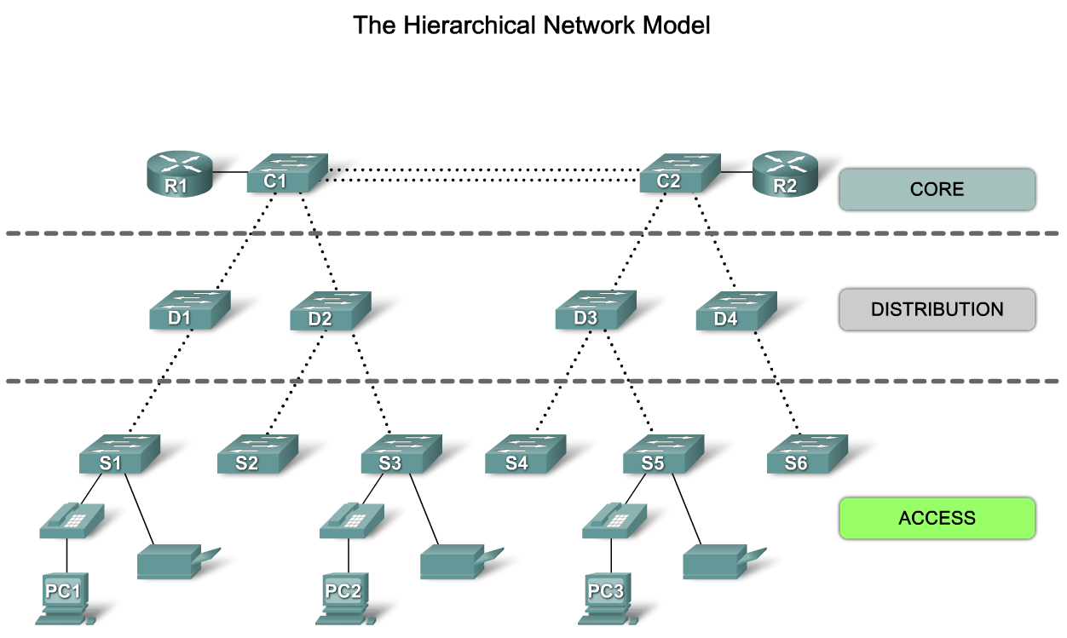
Describe how a Hierarchical Network Supports the Needs of a Small & Medium-Sized Business
Explain the benefits of the hierarchical network model

Slide 4
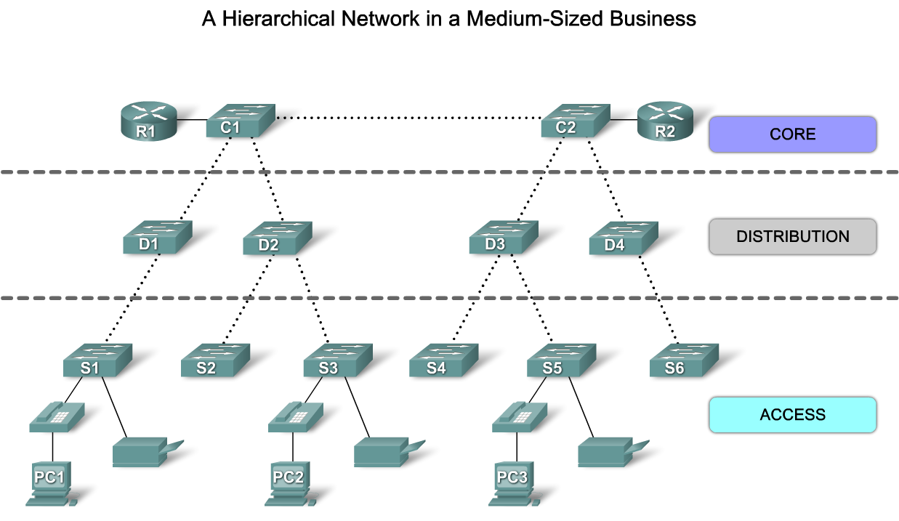
Describe how a Hierarchical Network Supports the Needs of a Small & Medium-Sized Business
Describe the key principles of hierarchical network design

Slide 5
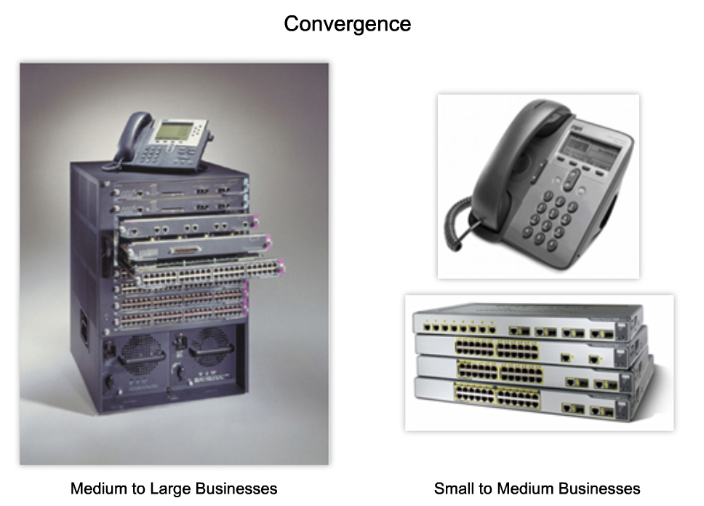
Describe how a Hierarchical Network Supports the Needs of a Small & Medium-Sized Business
Describe the role of a converged network in supporting small and medium-sized (SMB) business voice, video, and data needs

Slide 6
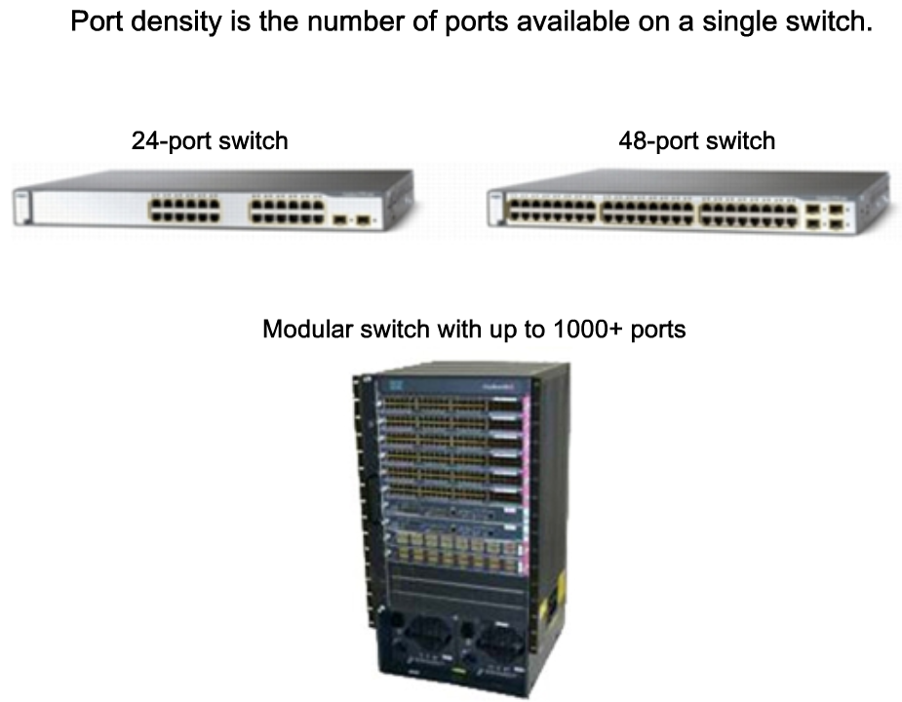
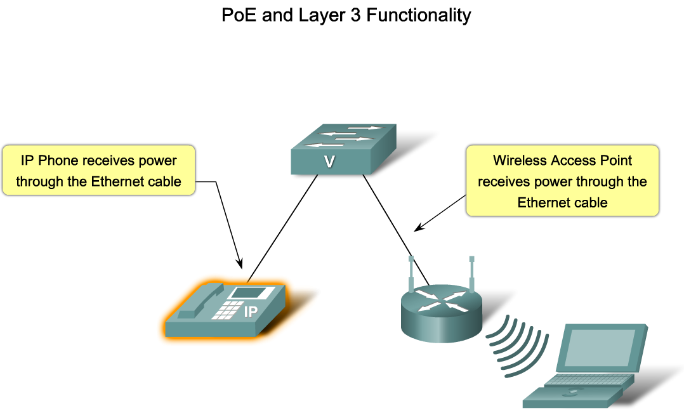
Match the Appropriate Cisco Switch to each Layer in the Hierarchical Network Design Model
Identify the considerations used to select a switch for a hierarchical network

Slide 7
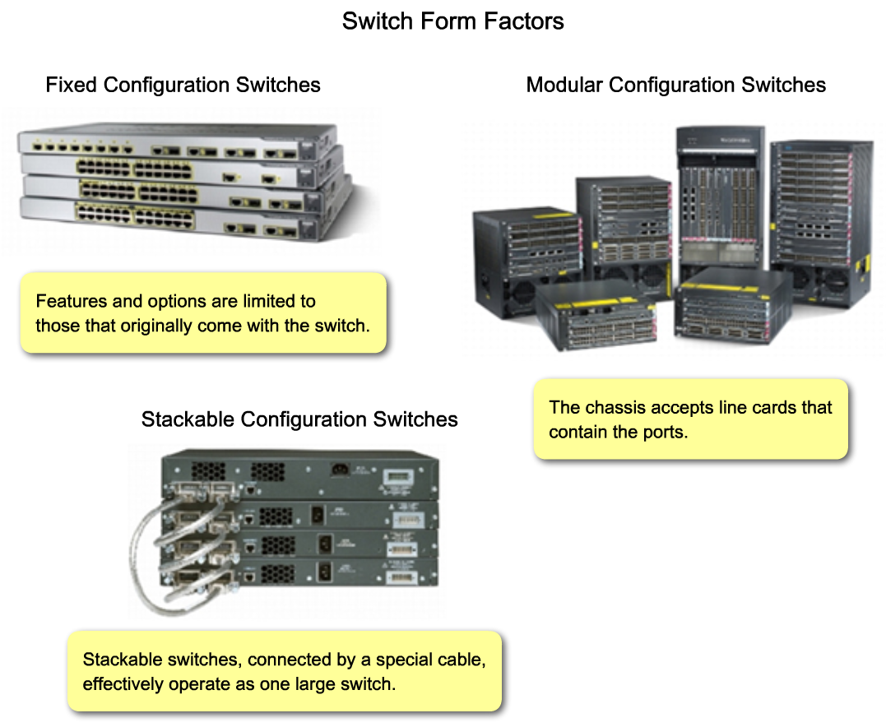
Match the Appropriate Cisco Switch to each Layer in the Hierarchical Network Design Model
Identify the key features of switches that are used in hierarchical networks

Slide 8
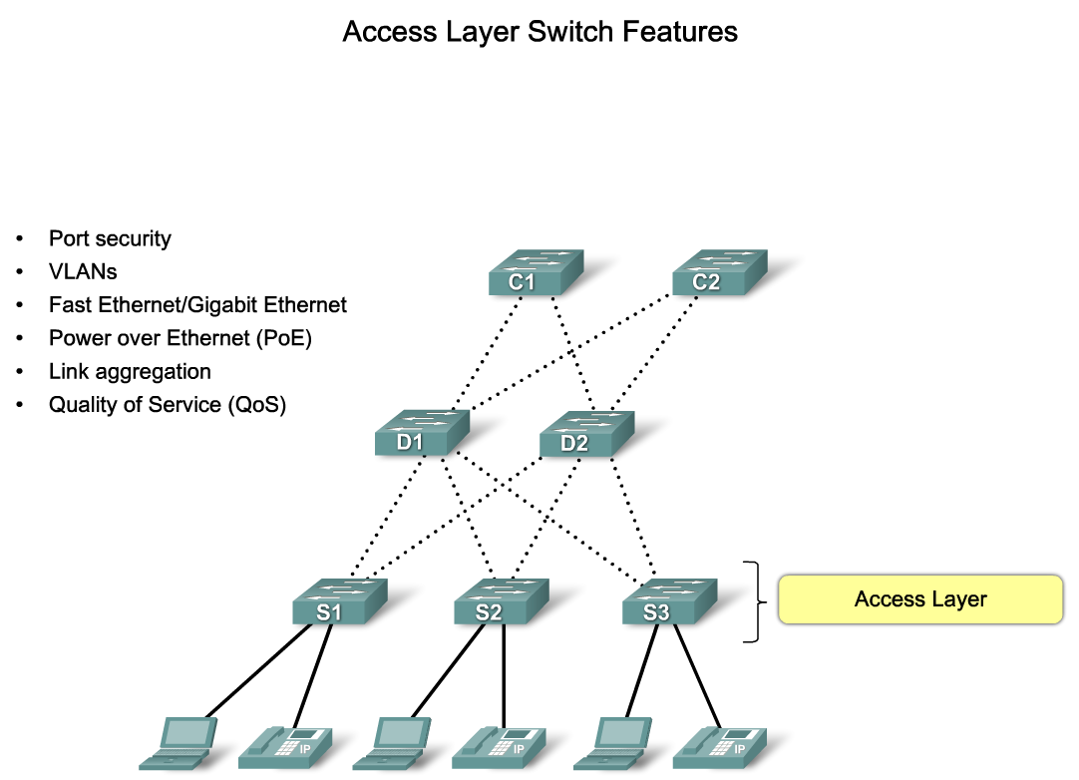
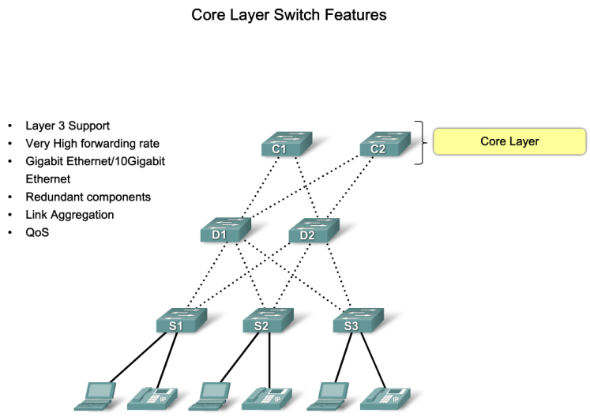
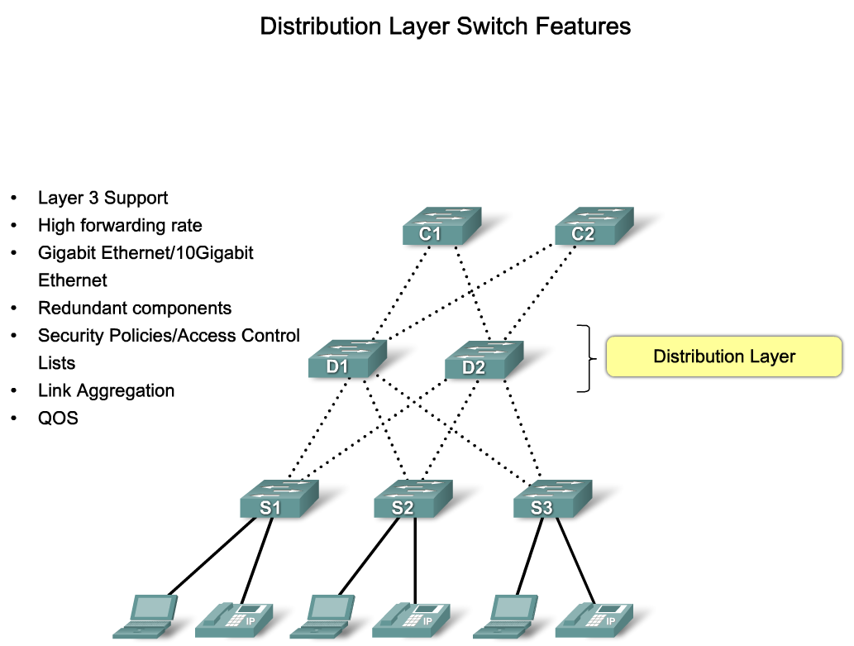
Match the Appropriate Cisco Switch to each Layer in the Hierarchical Network Design Model
Identify the switch features found in each level in a hierarchical network

Slide 9
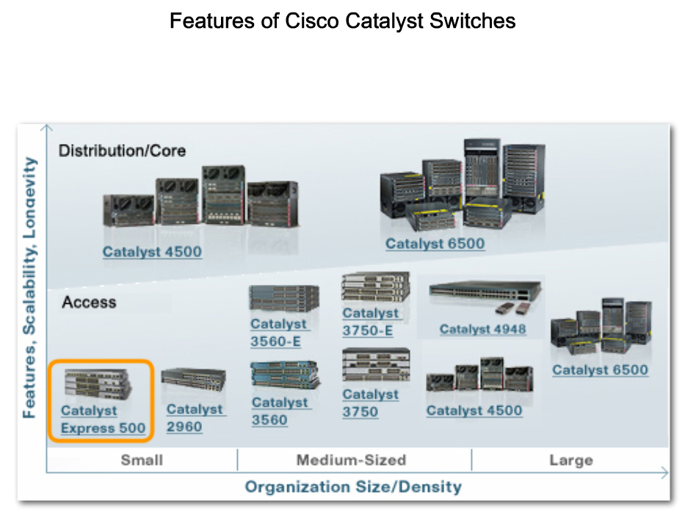
Match the Appropriate Cisco Switch to each Layer in the Hierarchical Network Design Model
Identify the Cisco switches used in SMB applications

Slide 10
Summary
Hierarchical Design model addresses performance, scalability, maintainability & manageability issues.
Traffic Analysis is used to monitor network performance.
Hierarchical Design Model is composed of 3 layers:
  Access
  Distribution
  Core
Switches selected for each layer must meet the needs of each hierarchical layer as well as the needs of the business.

